Slide 1
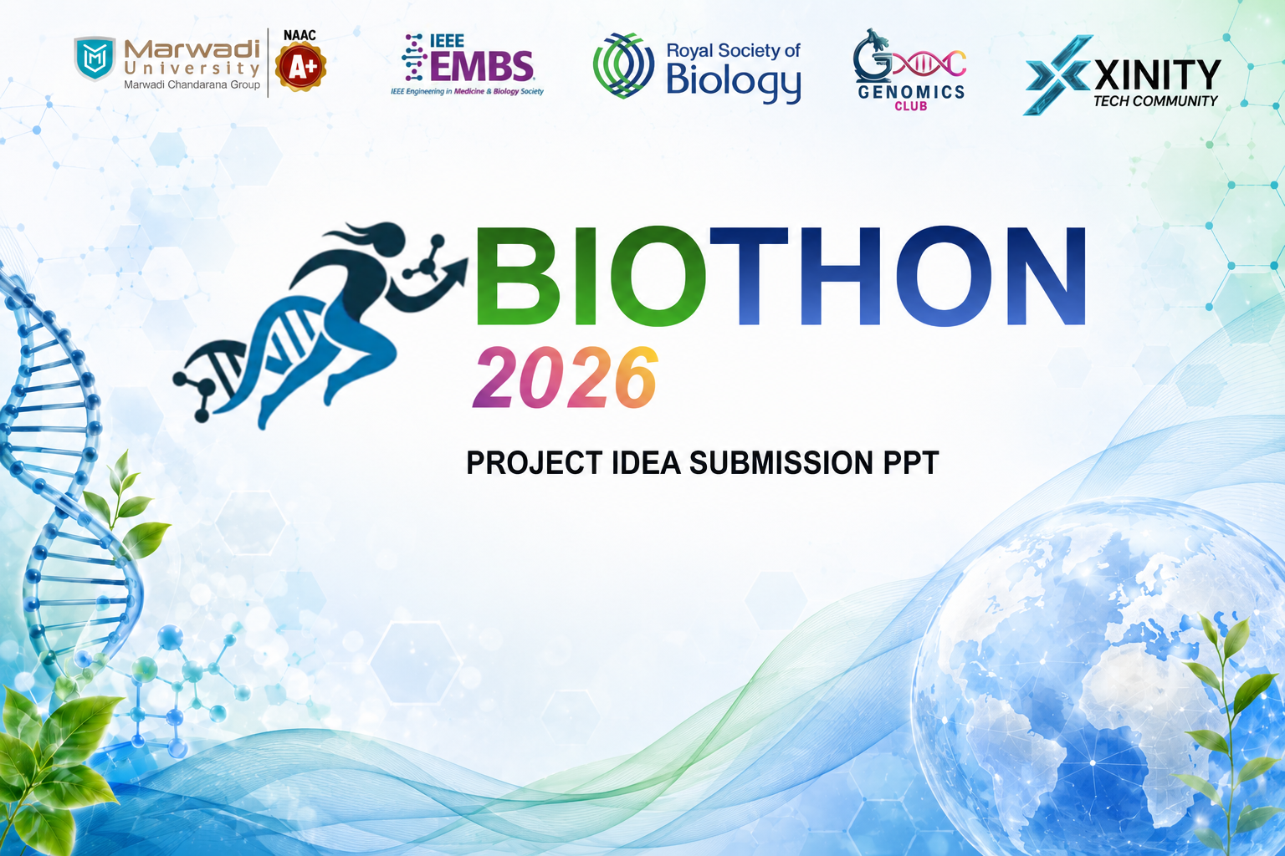

Slide 2


ADDING EXTRA SLIDE IS ALLOWED IN CASE OF SPACE CONSTRAIN

Slide 3

TEAM INTRODUCTION
TEAM NAME
TEAM LEAD
NAME-
COLLAGE-
YEAR-
SKILLS-
MEMBER-2
NAME-
COLLAGE-
YEAR-
SKILLS-
MEMBER-3
NAME-
COLLAGE-
YEAR-
SKILLS-
MEMBER-4
NAME-
COLLAGE-
YEAR-
SKILLS-

Slide 4
PROBLEM STATEMENT UNDERSTANDING
DESCRIBE YOUR DOMAIN AND EXPLAIN YOUR UNDERSTANDING OF THE PROBLEM STATEMENT YOU HAVE CHOSEN IN 4 TO 5 LINES

Slide 5
SOLUTION PROPOSED So
Solution / Product Name
EXPLAIN YOUR SOLUTION IN DETAILS

Slide 6
CORE FEATURES EXPLAIN
3 TO 4 FEATURES OF YOUR SOLUTION
EXPLAIN 3 TO 4 FEATURES OF YOUR SOLUTION IN DETAILS

Slide 7
INNOVATION & NOVELTY
What makes this solution stand out
CURRENT EXISTING SOLUTION IF EXIST
EXPLAIN THEM
Limitation 1 of existing solutions
Limitation 2 of existing solutions
Limitation 3 of existing solutions
Gap that remains unaddressed
YOUR IDEATION/INNOVATION EXPLAIN
Novel approach / technique we use
Advantage 2 over existing solutions
Advantage 3 - speed / cost / accuracy
How we bridge the existing gap

Slide 8
SOLUTION ARCHITECTURE & METHODOLOGY
Detailed Workflow - Explain how your solution work
EXPLAIN IN DETAILS STEP BY STEP
• Describe data source / input method and format
• Explain processing pipeline, algorithms or AI models used
• How output is generated and what decisions are made
• How the end-user interacts with the system

Slide 9
TECHNOLOGY STACK
Tools, frameworks and infrastructure you have used list them
FRONTEND
React / Flutter / HTML
Tailwind CSS / Material UI
Figma (UI Design)
BACKEND
Node.js / Django / FastAPI
REST API / GraphQL
Authentication: JWT / OAuth
AI/ML
Python / TensorFlow / PyTorch
Scikit-learn / OpenCV
LLM / RAG / Fine-tuning
DATABASE
MongoDB / PostgreSQL
Firebase / Supabase
Redis (caching)
CLOUD/IoT
OTHERS

Slide 10
IMPACT & REAL-WORLD USE CASES
Who benefits and how
PRIMARY USE CASE
Describe the main target user group and how they directly benefit from this solution in their daily workflow or life.
SECONDARY USE CASE
Describe a secondary beneficiary group could be government, hospitals, farmers, students and their specific benefit
SCALE/REACH
Describe the potential geographic or demographic reach districts, states, nationally or globally deployable.

Slide 11
BUSINESS & FUTURE PLAN
EXPLAIN IN DETAILS BUSINESS POSSIBLITIES OF YOUR SOLUTIONS

Slide 12


